Slide 1
Analysis of stakeholders’ Benefit
Customers
Reliability and Traceability of donation
Optimization of work
Fujitsu
Contribution to society (CSR)
Publicity of Fujitsu technology
Employees’ Experience
Profit from system
Community
Government
Decrease the number of children who cannot go to school
Contribute to SDGs target 4
Connect Supporters and Receivers

Slide 2
Customers (NGO,Company, Government) | value proposition? Will they benefit? How?
 | -Donation Tracking -Donation Targeting -Donation Certificates -Public Reports -Matchmaking -NGO can expand their business -Company and government can approach to Socially vulnerable which normally they can not
Suppliers (Fujitsu) | Dose it make suppilers' bussiness better?
 | good image (CSR) Fujitsu Responsible Business, Can contribute to society by using fujitsu system, Get opportunity to let people know about fujitsu sysytem
Employees (Fujitsu) | Will it employees happy?
 | Their work support children and their family life. It's honor, and they can be proud of it. They can have other opportunity and expand their business market

Slide 3
Financial (Fujitsu?) | Dose it make profit? How?
 | After prototype we can sell our system to other company or NGOs. It can be platform not for education but for medical helping example.
Community | Does it create good citizenship in the community? Does it follow local custom, law, and allow quality of life in the community? Sustainability/CSR? How?
 | -it contribute to SDGs target4 quality education -who use this platform contribute to Sustainability and CSR -it connects supporters and receivers -it will have a great impact of employment circulation(because of the education)
Government (ex.Japan) | Does it good for Government?
 | Government promote contribution to SDGs. Japan is one of the country in UN, so have a responsibility to support SDGs and contributes to it. It will have a great impact on financial circulation of the nation.

Slide 4
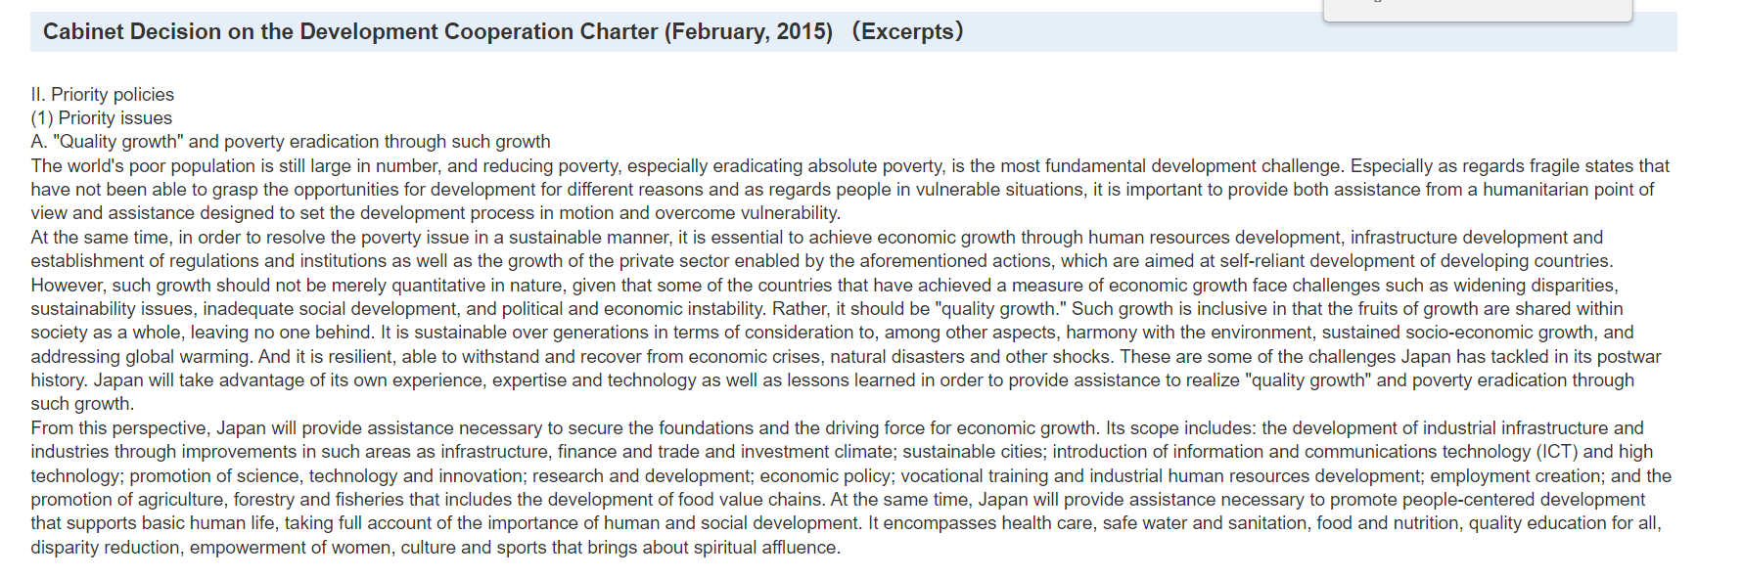
MOFA Japan: https://www.mofa.go.jp/policy/oda/sector/education/action.html
From this perspective, Japan will provide assistance necessary to secure the foundations and the driving force for economic growth. Its scope includes: the development of industrial infrastructure and industries through improvements in such areas as infrastructure, finance and trade and investment climate; sustainable cities; introduction of information and communications technology (ICT) and high technology; promotion of science, technology and innovation; research and development; economic policy; vocational training and industrial human resources development; employment creation; and the promotion of agriculture, forestry and fisheries that includes the development of food value chains. At the same time, Japan will provide assistance necessary to promote people-centered development that supports basic human life, taking full account of the importance of human and social development. It encompasses health care, safe water and sanitation, food and nutrition, quality education for all, disparity reduction, empowerment of women, culture and sports that brings about spiritual affluence.

Slide 5
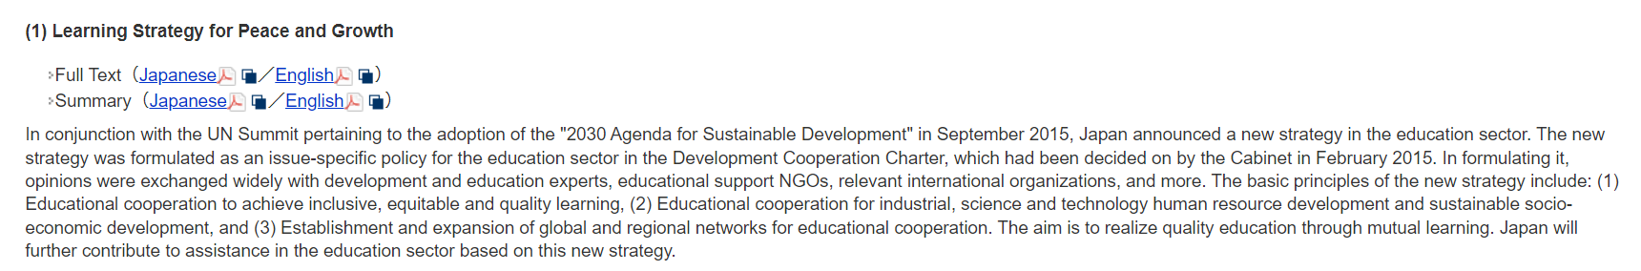
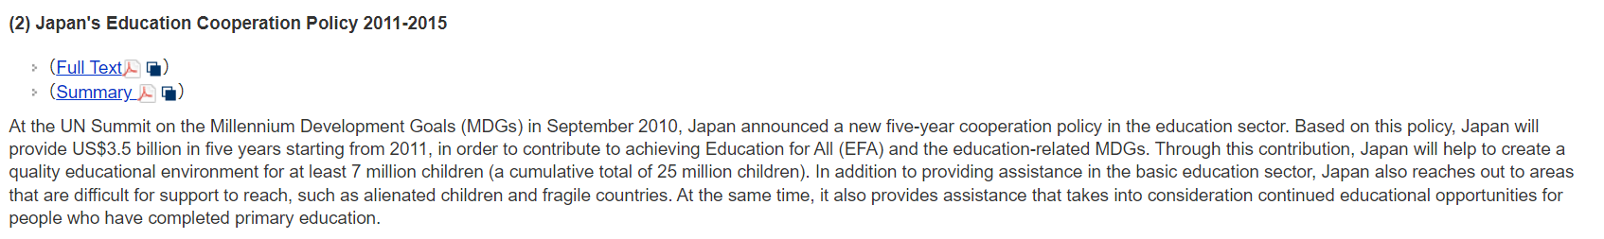
The basic principles of the new strategy include: (1) Educational cooperation to achieve inclusive, equitable and quality learning, (2) Educational cooperation for industrial, science and technology human resource development and sustainable socio-economic development, and (3) Establishment and expansion of global and regional networks for educational cooperation. The aim is to realize quality education through mutual learning. Japan will further contribute to assistance in the education sector based on this new strategy.
Based on this policy, Japan will provide US$3.5 billion in five years starting from 2011, in order to contribute to achieving Education for All (EFA) and the education-related MDGs. Through this contribution, Japan will help to create a quality educational environment for at least 7 million children (a cumulative total of 25 million children)

Slide 6
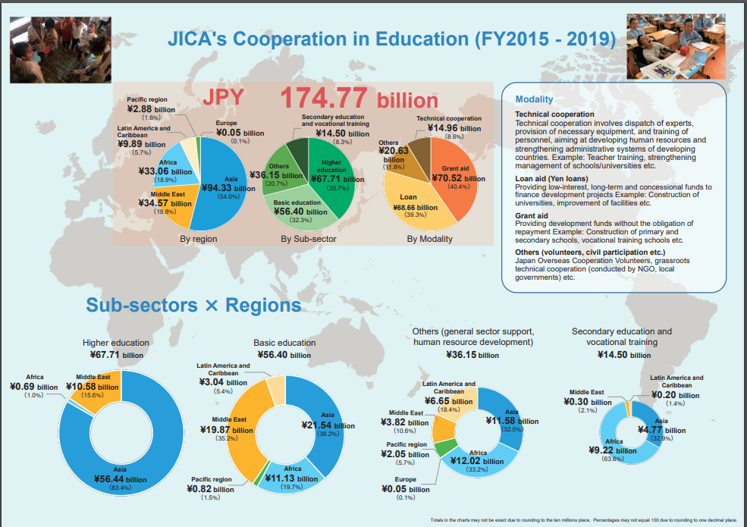
JICA: https://www.jica.go.jp/english/our_work/thematic_issues/education/c8h0vm0000am7dbv-att/brochure_01.pdf

Slide 7
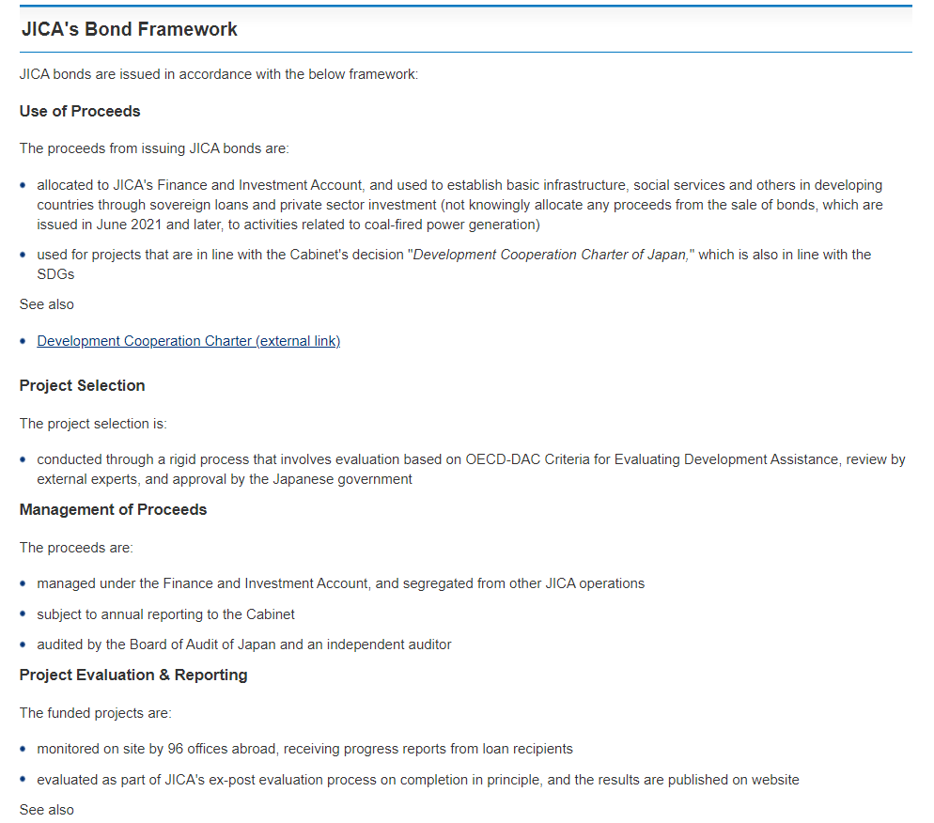
The budget of JICA
=Investment from Government and publishing JICA bonds
Some city governments and company buy this JICA Bond.
And it will budget of international cooperation that JICA does
https://www.jica.go.jp/english/ir/bonds/index.html

Slide 8
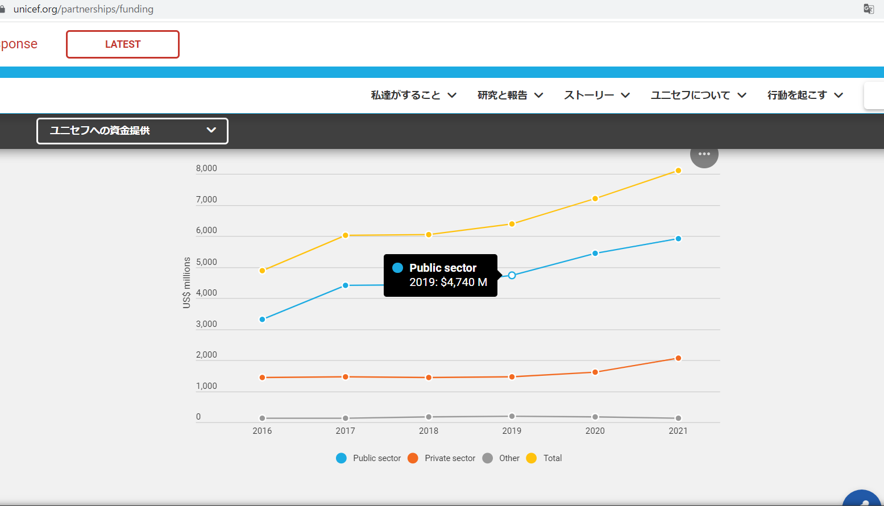
Unicef

